Slide 1
SVG
Smart Graphics for Network Publishing
January 24, 2001
Michael Bierman
Senior Product Manager, SVG

Slide 2
SVG
(Scalable Vector Graphics)
The XML grammar for describing rich vector graphics and dynamic information on the Web
Defined by the W3C
Organizations on SVG Working Group
Adobe
Apple
Autodesk
BitFlash
Canon
Corel
CSIRO
HP
Inso
IBM
ILOG
Kodak
Macromedia
Microsoft
Netscape
Oasis
Opera
Quark
RAL
Sun
Visio
Xerox

Slide 3

SVG Timeline
Candidate
Recommendation
Proposed
Recommendation
First
Meeting
SVG
Requirements
First
Public
Draft
Last
Call
Draft
Recommendation
Sep 98
Oct 98
Feb 99
Aug 99
Aug 00
Spring 01*
Summer 01*
* Speculative dates dependent on the W3C

Slide 4
Fitting into a Business Need
We will address our marketing messages toward the business solution that SVG enables:
  Helping professionals understand information faster by using interactive graphics
We call this market segment:
“Smart Graphics”

Slide 5

Smart Graphics Help People Interpret Information Faster
Information
Sources that Need Visual & Interactive Presentation
Sample
Aplications
Biz Reporting
Biz Analysis
CB Training
Automation Control Systems
Technical Simulations
Mapping
Technical Drawing & Diagrams
SCM / CRM / ERP
E-Commerce Systems
Smart
Graphics
Legacy Database
HR / Financials
Departmental Sources in Excel / MS Access
Technical Databases

Slide 6
Definition
Smart Graphics have the following characteristics:
  Allow the user to interact with the graphics and link to new sources of information
  Use animation, color and shapes to convey key points
  Easy to maintain, as they are either dynamically generated (e.g. JSP or ASP), or they are data-driven from backend databases using XML
    they are not a one-off…they are part of a systems architecture
  The data displayed within these applications can come from one, or multiple information sources within the company – typically using XML
  Can be run in web pages, e-documents (PDF), PowerPoint, Print and any Internet Appliance

Slide 7
How Graphical Information is Delivered Today
They are done using custom Java-based applications or static images with JPEG and GIF, or SWF:
  Java-based applications do not run inside the browser, and there is not a design tool that authors a Java UI
  GIF and JPEG images are flat and static – they cannot easily change based on user input or change in real-time based on back-end system changes
  SWF proprietary, binary format makes integration with heterogeneous legacy systems and common Web technologies difficult or impossible and expensive

Slide 8
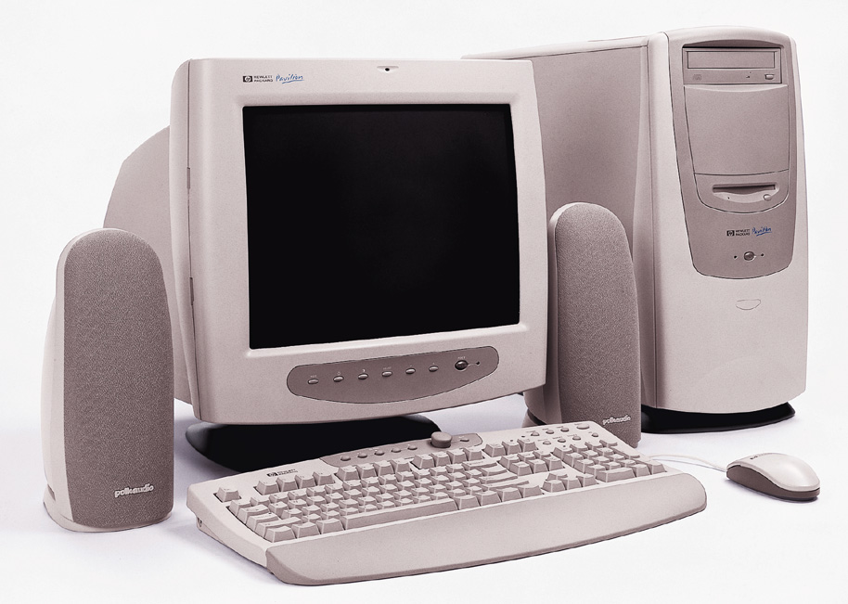



Where are the Applications Delivered?
Browsers
75% of our target developers will write applications for browser delivery
XML is used by approximately 20-30% of these developers, and rising
Is cross-application viewing a logical next step for this programming investment?
Smart
Graphics
PDF
Desktop
Apps
*North American Developer Opinion Survey, Spring 2000

Slide 9
Sum up
Designers Design; Coders code
Use the tools you have an investment in
Separate the presentation of the information and the presentation (say a graphic, chart, etc.)

Slide 10
How SVG Wins
Buying / investment criteria for our target customer:
Open Industry standard vs. a closed file format
Text based format that can be hand coded or directly generated (e.g. PHP, ASP, JSP)
Unlimited data presentation options
Separates presentation from content
Drive values of graphical content from a data source
Tools from a wide-range of third party vendors

Slide 11
Who Creates Smart Graphics
Teams of Designers and Developers…
Seeking an efficient, compelling way of presenting information to business line managers
Developing Web applications

Slide 12
Demos

Slide 13

XML Markup Languages
XML for Business Cards
  XML basics: elements and attributes
  DOM (Document Object Model)
Standard XML Markup Languages
XML for HTML

Slide 14
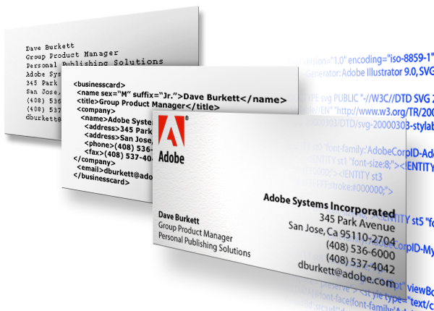
XML Provides Structure;
XSL/CSS Convey Style
Example: XML for business cards
Unformatted
Data
Structured
XML Data
Final Form

Slide 15
Value Proposition
For the first time Web Developers and Designers have a graphics file format that gives them full control over the presentation of data-driven web applications
  Proof points
    SVG separates presentation from content
    SVG is text-based vs. binary, so it can be dynamically generated from today’s ASP or JSP servers, or hand-coded
    It is XML based and therefore well-known by our customer base
    Easily connects to back-end systems with legacy data from hetero or homogeneous networks
    SVG text is searchable and selectable
Notes:
Web applications
Dynamic content
UI
Content
Rich, Platform Neutral content

Slide 16
Customer Statement
  “From my perspective I have seen three major uses of Flash.
    Entertainment (cartoons, games, and toys)
    Content presentation (in most cases a fancy slide show, like a nice PowerPoint presentation on the web)
    Enhanced navigation (when the developer wants more than just an image swap)
  When thinking of these three categories and comparing SVG to Flash the first thing that comes to mind is the need for dynamic content. In Flash this support came as an after thought, but it is at SVGs core.
  If a site needs to be updated more than once a quarter then SVG is the way to go. “
    Wade Harrell
    freelance web developer
    wade@traunic.com

Slide 17

bc

Slide 18
Flash Positioning
Macromedia Tech Support Representative on the SVG developer news-group:
  From: jdowdell@macromedia.com [mailto:jdowdell@macromedia.com]
  Sent: Wednesday, January 10, 2001 1:11 PM
  To: svg-developers@egroups.com
  Subject: Re: [svg-developers] hehe, SVG plugin for Flash and Shockwave?
  Question: I have heard this asserted before, can anyone point me to Flash 5 documentation that explains what this actually means?
  From John Dowdell - Macromedia Tech Support, San Francisco CA US
  The Shockwave Player has exPat built into it, and the smaller Macromedia Flash Player has a simpler size-optimized XML parser built into it. If you haven't done so already I'd recommend downloading the Macromedia Flash 5 trial version, although if you prefer you download just its documentation: http://www.macromedia.com/support/flash/
  The XML parsing inside the Macromedia Flash Player is mainly for node manipulation... there's no validation, no resolution of internal or external entities, no namespace or extended link or stylesheet support... it's just simple data parsing with a small footprint for extended distribution.

Slide 19

Tools in the XML Workflow
Creation Tools
Layout Tools
Multi-Channel
Delivery
Dynamic Graphics,
Database Integration,
Rasterization
SVG Files
High Quality,
Dynamic, Data driven
Web, PDA’s and
Wireless

Slide 20
Authoring Tool Characteristics

Slide 21
What Do Customers Require for Authoring Smart Graphics
Five key categories of authoring tool functionality:
  Presentation
  Data Access
  Interactivity
  Debugging
  Asset Management

Slide 22
Authoring Topics
Presentation – need a GUI
  Layout of assets
  Preview mode
  Timeline Animation
  Template creator to bind with a server for data-driven graphics
  Media handling (vector, raster, video, audio)
Data Access – text driven
  DTD Editor
  Meta Data Editor
  Bind objects to a database field
  Describe data type (ie – dollars, dates)
  Pre-configured templates for data access using the following:
    CGI, PERL
    Cold Fusion
    ASP, JSP

Slide 23
Authoring Topics
Interactivity
  Create simple events
  Create complex events by assigning scripts to an object
  Create actions for those events
Debugging
  Views for looking at the SVG file in different ways:
    DOM Tree, Scripts
  Real-time reporting tool
    Memory usage, values in elements at a certain time
    CPU utilization, Profiling

Slide 24
Authoring Topics
Asset Manager
  Access to version control software via WebDav
  Ensure linked files are in proper location and validated
  Re-allocate links
  External assets switch to and from embedded
  Global/specific search and replace

